Slide 1

ADNAN Kureshi
(204550307049)
Harsh Vyas
(204550307006)
AnISH KArleKAR
(204550307031)
Jay SANGANI
(204550307017)

Slide 2
01.
INTRODUCTION
02.
PROBLEMS
contents OF THE PRESENTATION
03.
OBJECTIVES
04.
MODULE

Slide 3
05.
TECHNICAL REQUIREMENTS
06.
FRONTEND
contents OF THE PRESENTATION
07.
BACKEND
08.
DETAILED DESCRIPTION

Slide 4
INTRODUCTION

Slide 5
INTRODUCTION
Our project is an online store, it attempts to serve as a marketplace where people can sell their used or unwanted items.
People can make money by selling their scrap, and artists can purchase those items at low cost and make money by showcasing their creativity on them.
This creative items can be purchased by any user on our website.

Slide 6
PROBLEMS

Slide 7
PROBLEMS
As we can see the rising number of unemployment in our country. That’s why, We came up with an idea of our website “SCRAP UP”
People get rid from there unwanted items by throwing them as waste , which leads to pollution.
Increase of wasteland.

Slide 8
OBJECTIVES

Slide 9
OBJECTIVES
Our website offers the service of transforming outdated and uninteresting products into unique and useful ones.
Our website interlink art, creativity and waste into sustainable functional products handcrafted by local Indian artisans.
Any creative item on our website can be purchased by a user with ease.

Slide 10
MODULES

Slide 11
MODULES
Registration
User
Creator
Admin

Slide 12
TECHNICAL REQUIREMENTS

Slide 13
TECHNICAL REQUIREMENTS
Computer or Phone
Internet Browser

Slide 14
FRONTEND

Slide 15

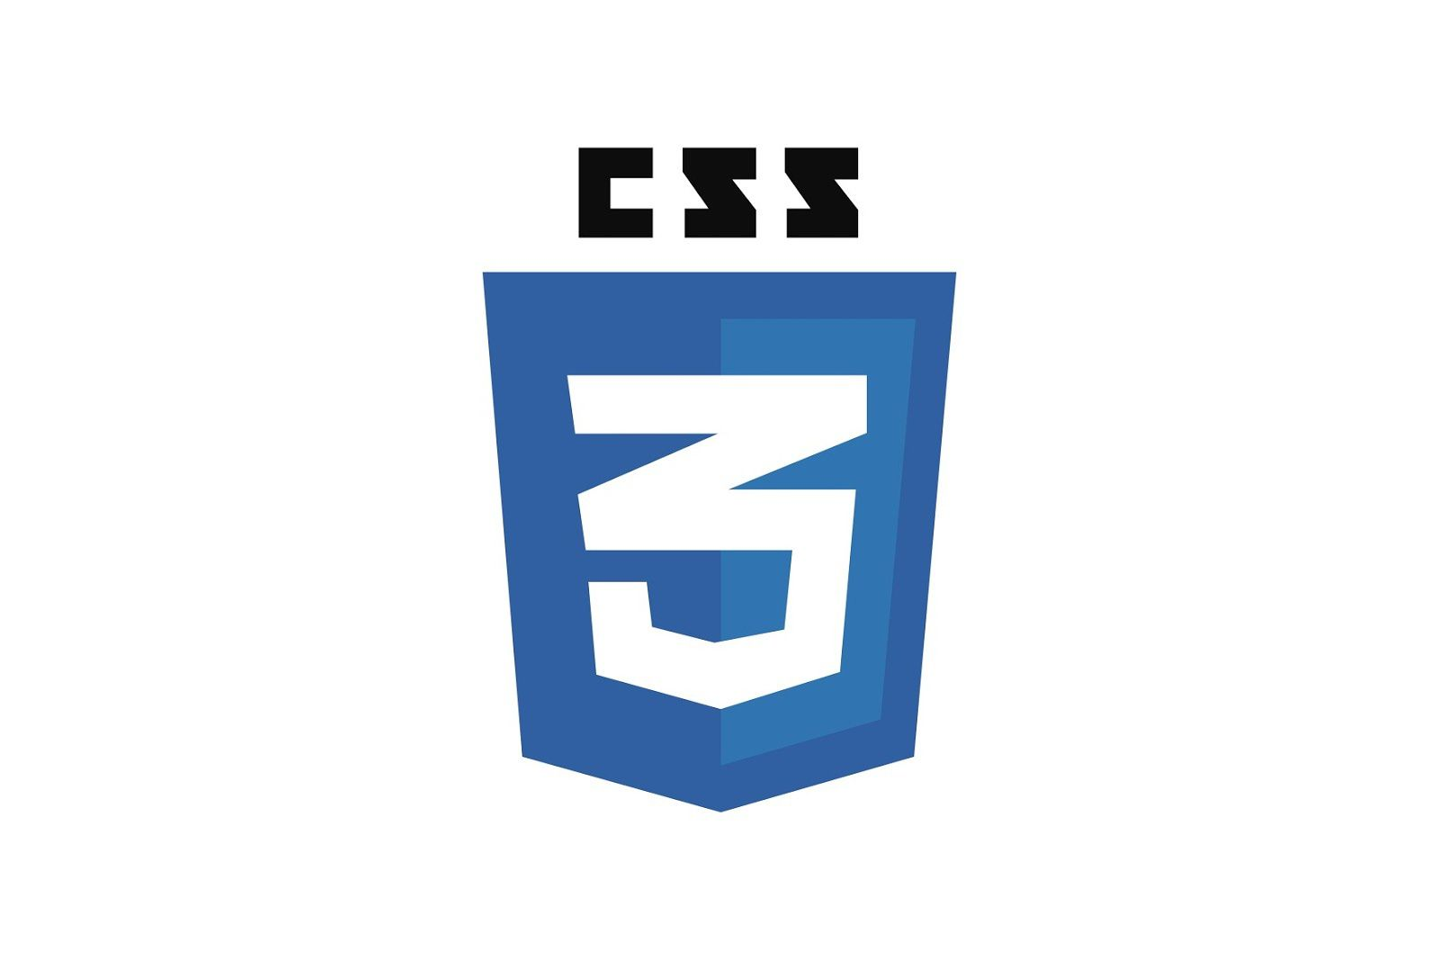


FRONTEND
HTML
CSS
JAVASCRIPT
BOOTSTRAP

Slide 16
BACKEND

Slide 17


BACKEND
PHP
MYSQL

Slide 18
DETAILED DESCRIPTION

Slide 19
DETAILED DESCRIPTION
Our website is basically decided into two sections:
Creator
Seller/buyer
So on the creator side, people who have registrated as creator can sell the decorative items.

Slide 20
DETAILED DESCRIPTION
And on the buyer/seller side, seller can sell useless or unwanted items.
And buyer can buy the new items created by the creator.

Slide 21
PAGES INFORMATION

Slide 22
PAGES INFORMATION
login page
Registration Page
Home page
Product Page
Cart
Profile Page
Check out Page
About US Page
Contact Us Page
Track Order Page
Creator Portfolio
Creator Product page

Slide 23
SOFTWARE DEVELOPMENT MODEL

Slide 24
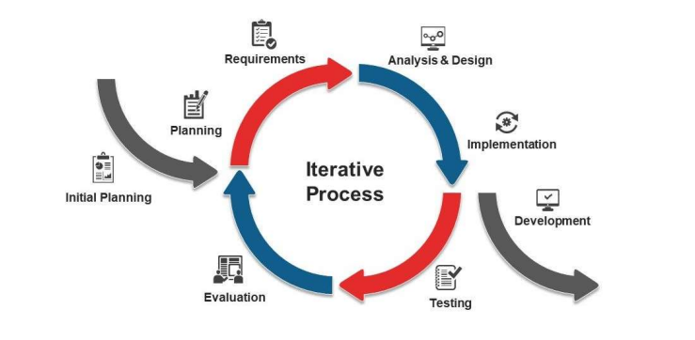
SOFTWARE DEVELOPMENT MODEL

Slide 25
SOFTWARE DEVELOPMENT MODEL
Iterative process starts with a simple implementation of a subset of the software requirements and iteratively enhances the evolving versions until the full system is implemented. At each iteration, design modifications are made and new functional capabilities are added. The basic idea behind this method is to develop a system through repeated cycles (iterative) and in smaller portions at a time (incremental).
Consider an iterative life cycle model which consists of repeating the following four phases in sequence: Requirements Phase: In the requirements phase of software development, the system related information is gathered and analyzed. The collected requirements are then planned accordingly for developing the system.

Slide 26
USE CASE

Slide 27
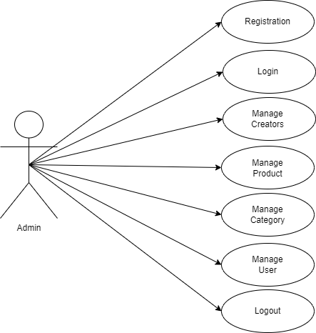
UsE CasE FOR ADMIN

Slide 28
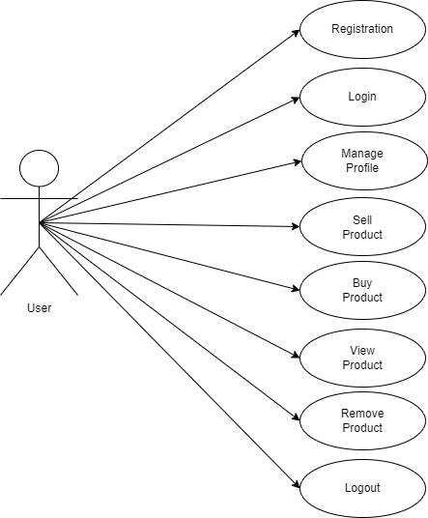
USE CASE FOR USER

Slide 29

USE CASE FOR CREATOR

Slide 30
DATA FLOW DIAGRAMs

Slide 31
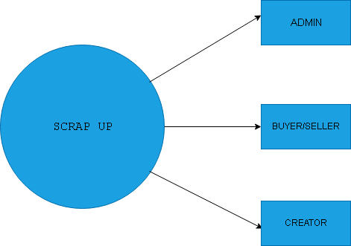
DFD

Slide 32
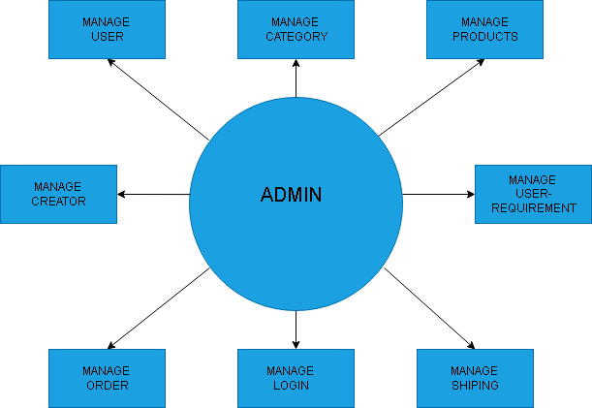
Dfd FOR ADMIN

Slide 33
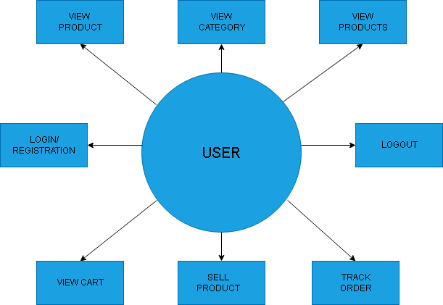
Dfd FOR user

Slide 34

Dfd FOR CREATOR

Slide 35
ACTIVITY DIAGRAMs

Slide 36
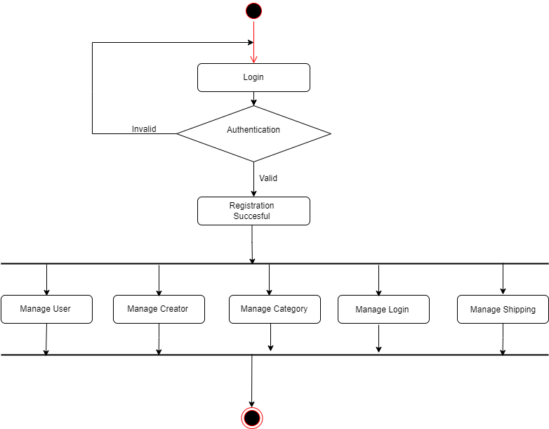
Activity diagraM FOR ADMIN

Slide 37
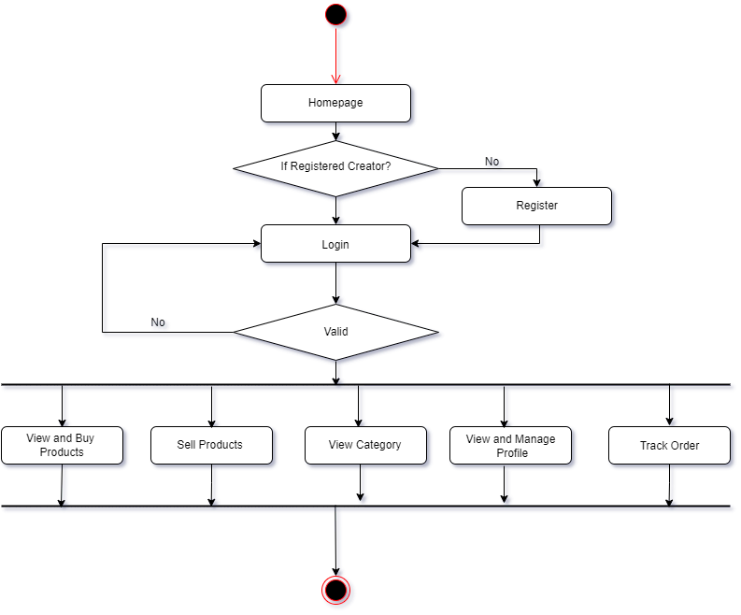
Activity diagraM FOR CREATOR

Slide 38
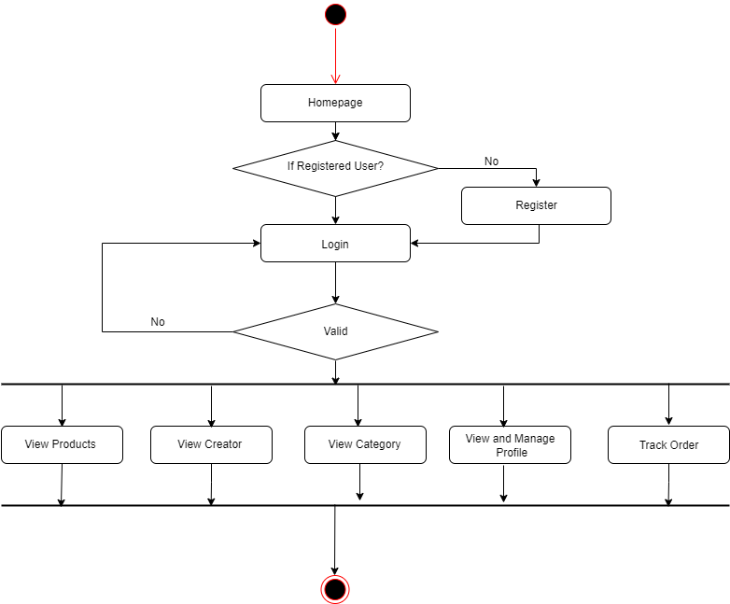
Activity diagraM FOR user

Slide 39
TIMELINE DIAGRAMs

Slide 40
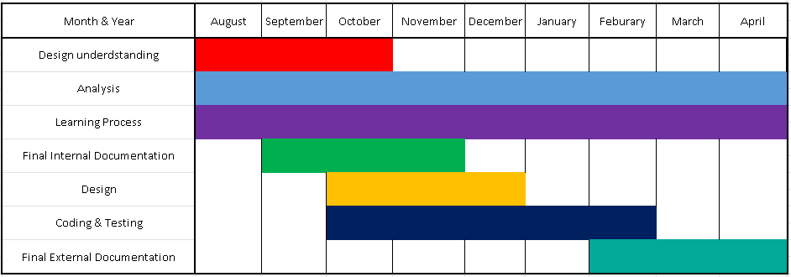
TIMELINE diagraM

Slide 41
ER DIAGRAM

Slide 42
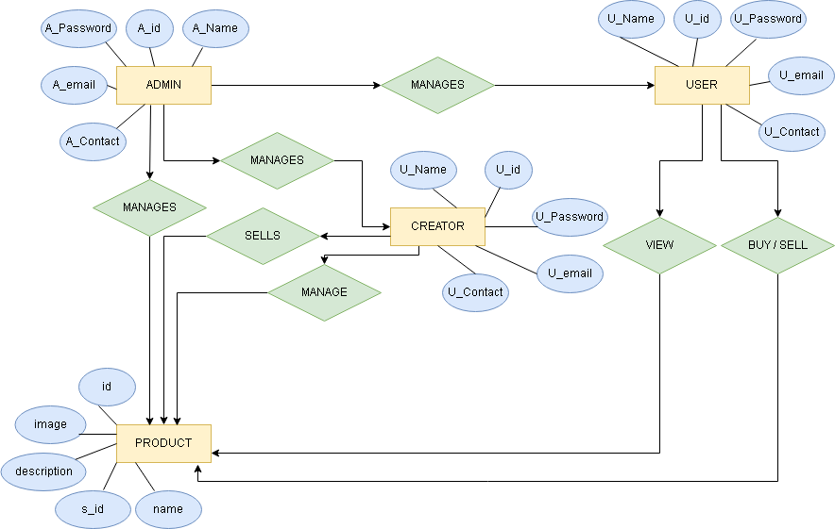
ER diagraM

Slide 43
MOCKUPS

Slide 44
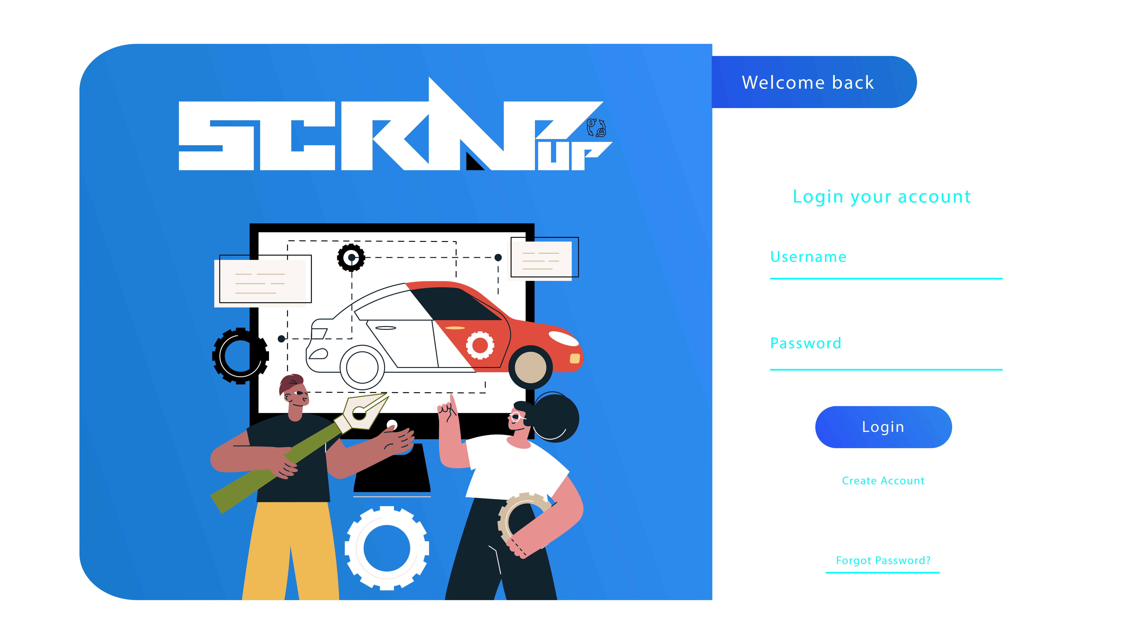
MOCKUPS

Slide 45
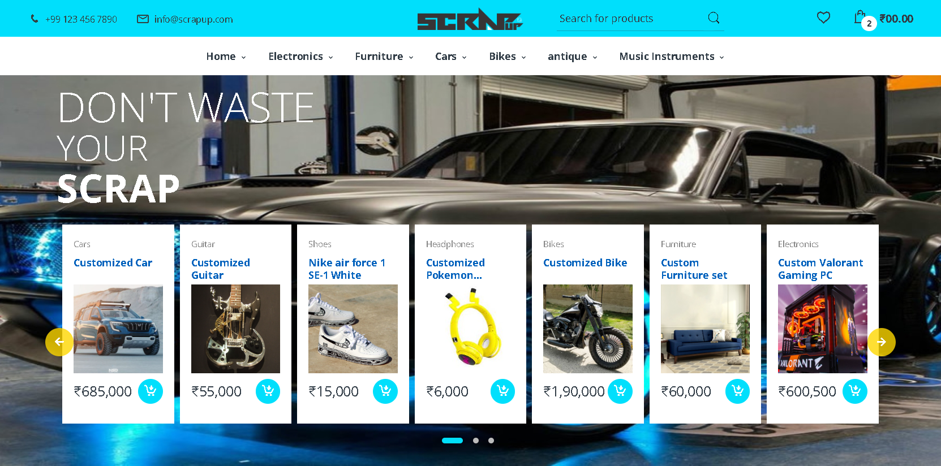
MOCKUPS

Slide 46
THANK YOU ☺

